Slide 1
Smart Home Calendaring and Notification System
Team 2 Hojun Jaygarl, Nam Pham, Andrew Denner

Slide 2
Introduction
Overview
Brief introduction—Andrew
Description—Andrew
System Requirements—Nam
System Verification—Hojun

Slide 3
Overview of System
The Targeted user demographic elderly and disabled persons
Users Unique Issues
Decline in cognitive function
Medical issues/Dietary needs
Medical Appointments
Other senior activities
User’s desire to remain independent

Slide 4
Overview of System (cont.)
Current existing systems
Complex and “scary”
Poorly integrated

Slide 5
Overall description
What does the Notification and Calendaring System (NCS) do?
Schedule management
Notification
Planning
Nam will go into this further next

Slide 6
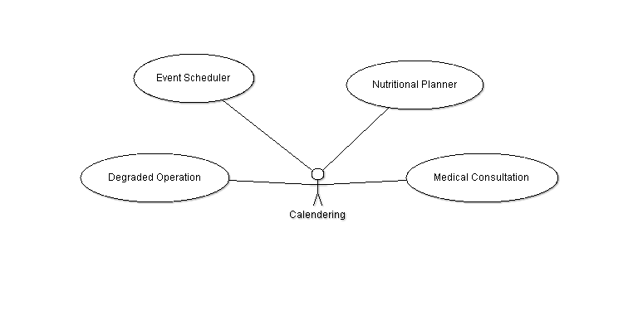
Function Diagram—Calendering Subsystem

Slide 7
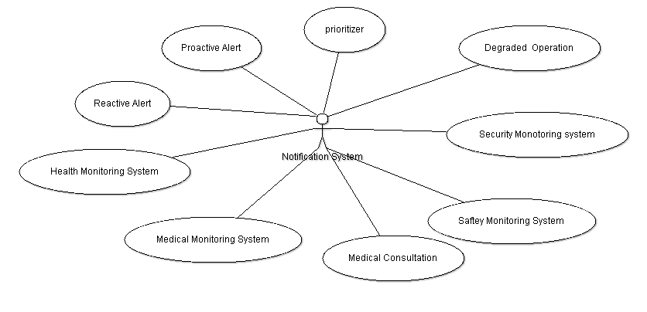
Function Diagram—Notification Subsystem

Slide 8
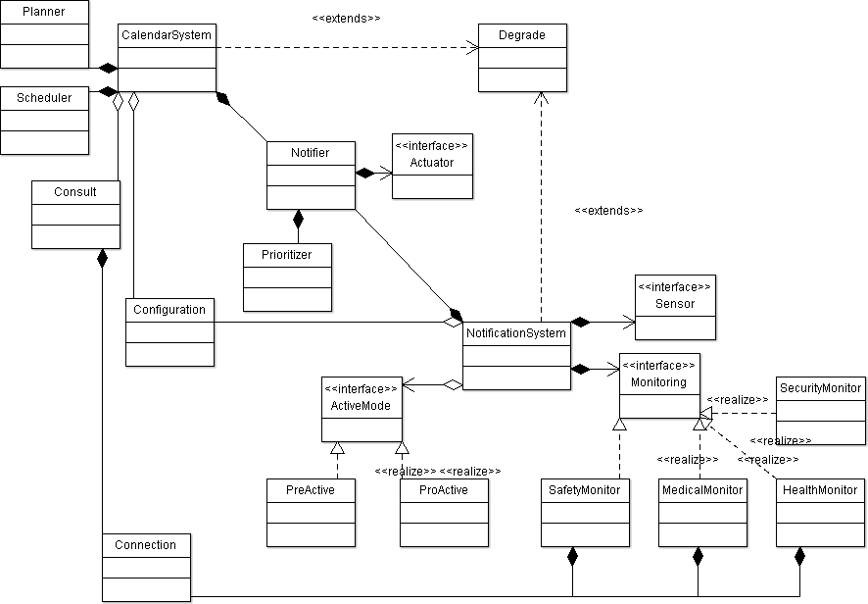
Class diagram

Slide 9
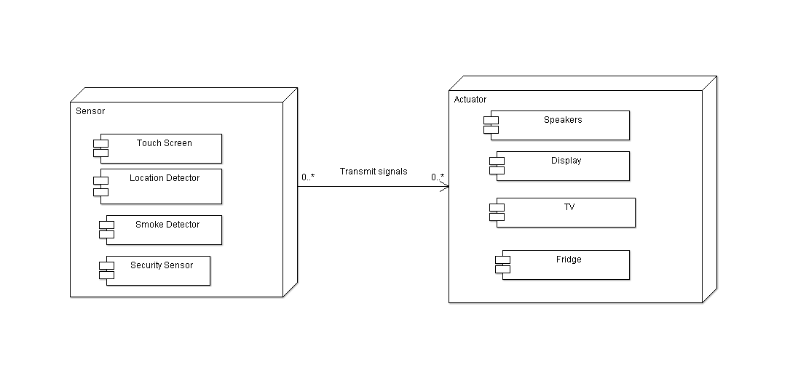
Deployment Diagram

Slide 10
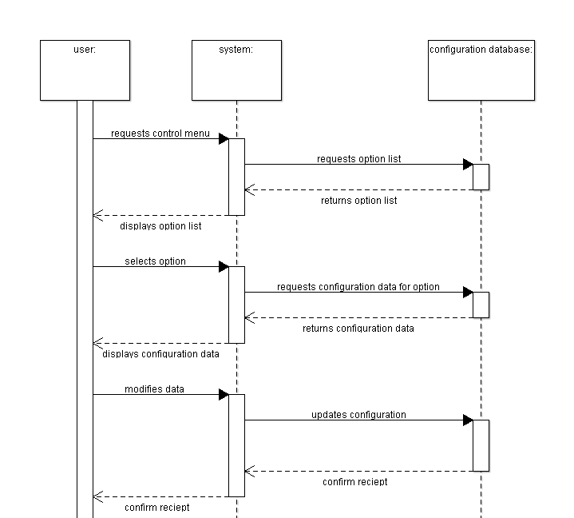
Sequence diagram for
User level control

